Slide 1
Subnet Mask

Slide 2
Network Segmentation (1 of 2)
When a network is segmented into multiple smaller networks, the following occurs:
Traffic on one network is separated from another network’s traffic
Each network is its own broadcast domain
Segmentation accomplishes the following goals:
Enhance security
Improve performance
Simplify troubleshooting

Slide 3
Network Segmentation (1 of 2)
Networks are commonly segmented according to one of the following groupings:
Geographic locations
Departmental boundaries
Device types

Slide 4
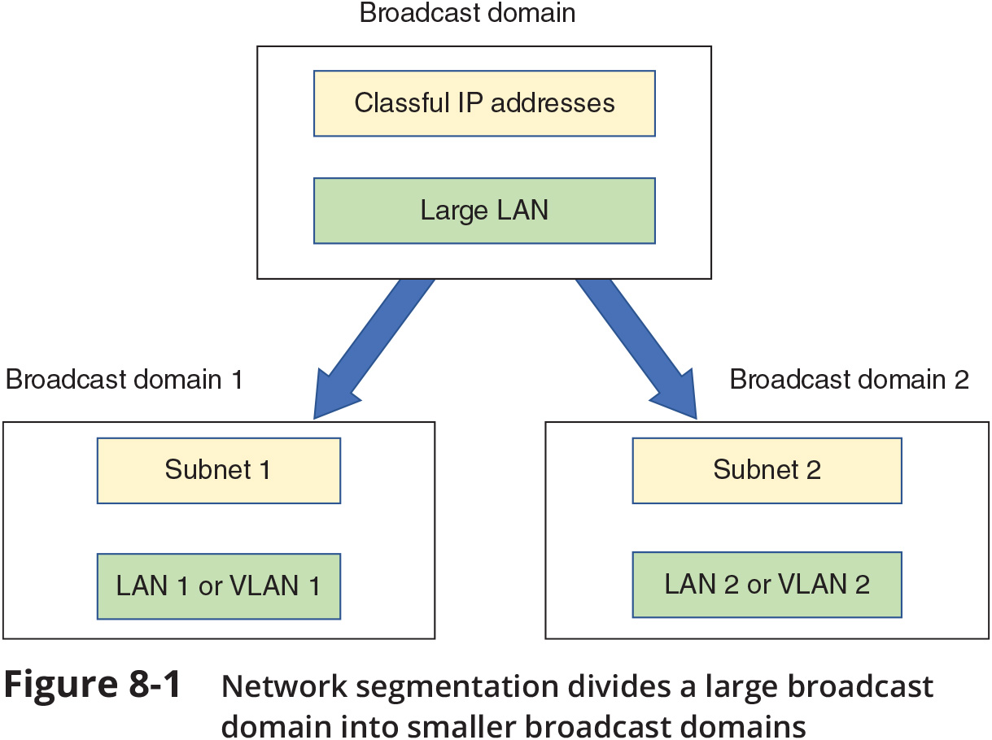
Network Segmentation (2 of 2)

Slide 5
Why Subnets?
Example: A business has grown from 20-30 computers to having a few hundred computers on three floors
There is only a single LAN or broadcast domain
One router serves as the default gateway for the entire network
To better manage network traffic, segment the network so that each floor contains one LAN, or broadcast domain

Slide 6
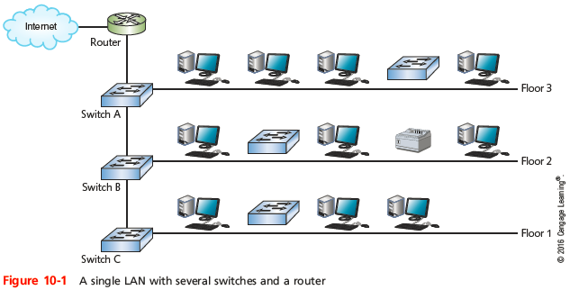
Why Subnets?
Notes:
Why Subnets?

Slide 7
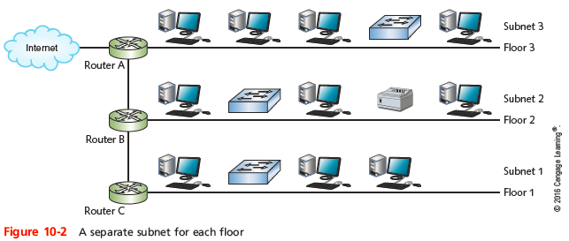
Why Subnets?
Notes:
Why Subnets?

Slide 8
Subnet Masks (1 of 2)
Example: A business has grown from 20-30 computers to having a few hundred computers and devices
There is only a single LAN or broadcast domain
One router serves as the default gateway for the entire network
To better manage network traffic, segment the network so that each floor contains one LAN, or broadcast domain
You will need to configure clients on each subnet, so they know which devices are on their own subnet
Divide the pool of IP addresses into three groups or subnets (a technique called subnetting)

Slide 9
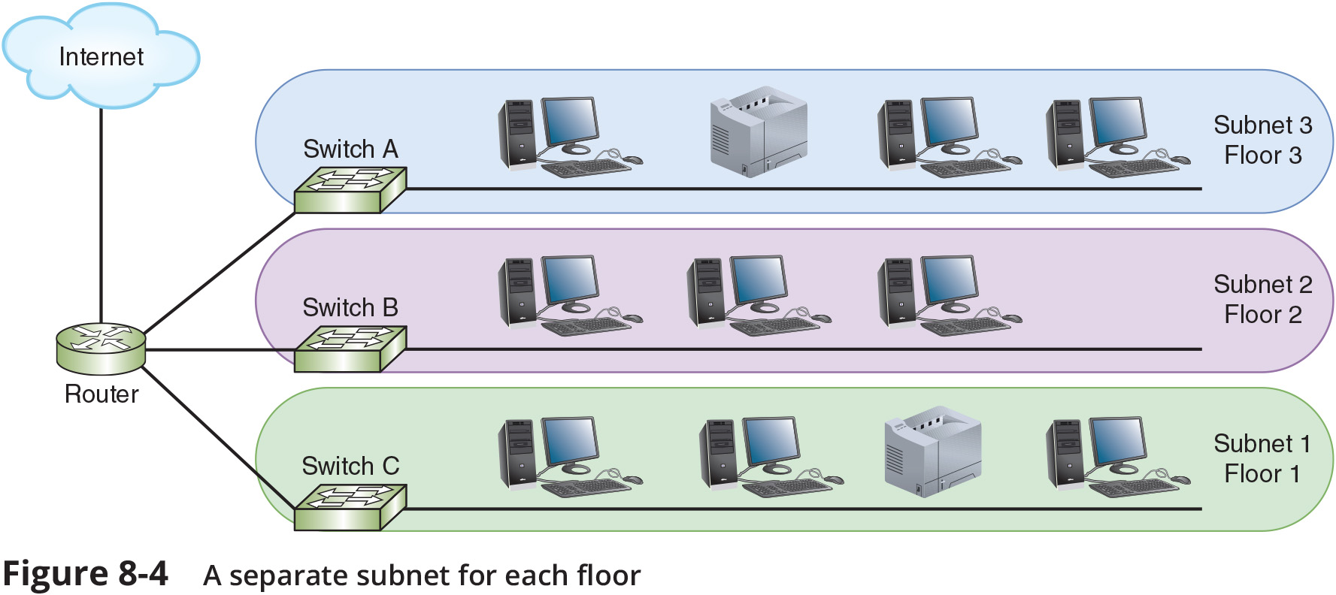
Subnet Masks (2 of 2)

Slide 10
How Subnet Masks Work
An IPv4 address is divided into two parts: a network ID and a host ID
A subnet mask is used so devices can determine which part of an IP address is the network ID and which part is the host ID
The number of 1s in the subnet mask determines the number of bits in the IP address belong to the network ID
IP address 192.168.123.132 in binary:
11000000.10101000.01111011.10000100
Subnet mask 255.255.255.0 in binary:
11111111.111111111.111111111.00000000
Network ID: 192.168.123.0
Host portion: 0.0.0.132

